Slide 1
Post Mortem fourth stage
Feline panleukopenia
Dr. Budoor Muhammad
Department of Pathology and Poultry Disease
College of Veterinary Medicine university of Basrah

Slide 2
Feline panleukopenia
Feline panleukopenia (also called feline distemper) is a highly contagious, potentially fatal disease of cats caused by the feline panleukopenia virus (FPV, also called feline parvovirus).

Slide 3
Epidemiology
Most species of Felids are highly susceptible to infection which is generally endemic in unvaccinated cats.
Cats of all ages are susceptible to infection.
Disease occurs in young recently-weaned kittens, as maternally-derived antibody levels wane. High rates of virus excretion occur during the acute stages of the disease, mainly in feces but also in saliva, urine, vomitus and blood.
Cool, moist, dark environment is most susceptible for this disease.
fleas and humans act as mechanical vector for this disease.

Slide 4
Clinical Signs
Most cats with FPV infection have no signs at all and appear normal. Cats that do become ill—most often those younger than a year old—may have the following:
Diarrhea and Vomiting
It causes a decrease in the cats white blood cells
Fever
Depression/lethargy
Loss of appetite
Dehydration (may appear as sunken eyes or dry gums)
Painful bell
Affected cats—especially kittens—also may suddenly die

Slide 5
Dehydration is prominent clinical signs of feline panleukopenia.

Slide 6
Lesions
identification of lesions within the intestines, brain and spinal cord, or lymph tissue during necropsy.
Intestinal congestion

Slide 7
Intestinal congestion

Slide 8
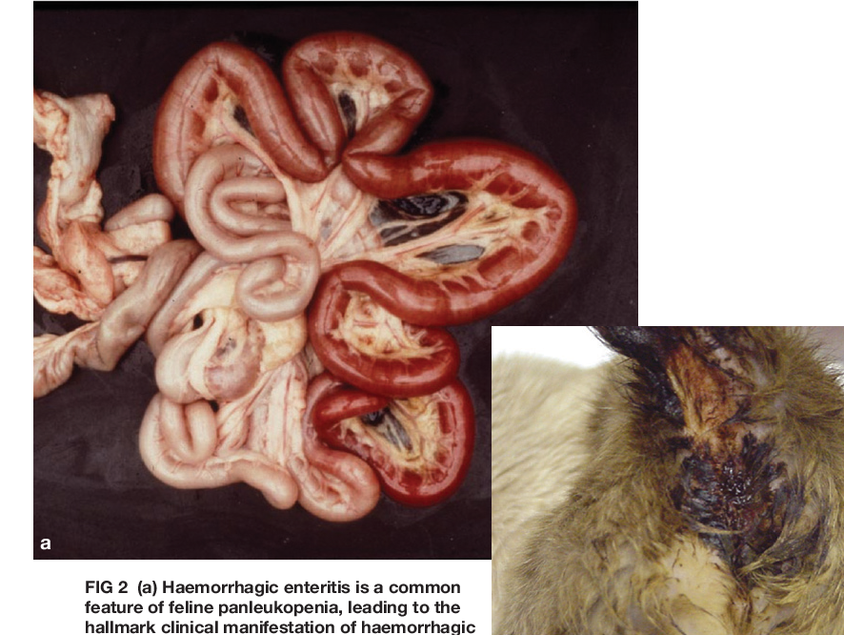
diarrhea
mm

Slide 9
Intestinal mucosal hemorrhage

